Slide 1

Systems Analysis & Design

Slide 2
Analysis Phase

Slide 3
Outline
The analysis phase.
Requirement determination.
Requirement elicitation techniques.
Requirement analysis strategies.

Slide 4
THE ANALYSIS PHASE
Analys is refers to breaking a whole into its parts with the intent of understanding the parts’ nature, functions, and interrelationships.
The planning phase deliverables are the key inputs into the analysis phase.

Slide 5
(cont’d)
The basic process of analysis involves three steps:
Understand the existing situation (the as-is system)
Identify improvements
Define the requirement for the new system (the to-be system).
Notes:
1 – if you do not have a current system there is no step like this.

Slide 6
(cont’d)
The final deliverables of the analysis phase is the system proposal.
The system proposal is presented to the approval committee in the form of a system walk-through to explain the system in moderate detail.
The deliverables from the analysis phase are the first step in the design of the new system.

Slide 7
REQUIREMENTS DETERMINATION
Requirements determination is performed to transform the system request’s high-level statement of business requirements into a more detailed, precise list of what the new system must do to provide the needed value to the business

Slide 8
What is a Requirement?
A requirement is a statement of what the system must do or what characteristics it needs to have.
Requirements describe
what the business needs
(business requirements)
what the users need to do (user requirements)
what the software should do
(functional requirements)
characteristics the system should have
(non-functional requirements), and
how the system should be built
(system requirements)

Slide 9
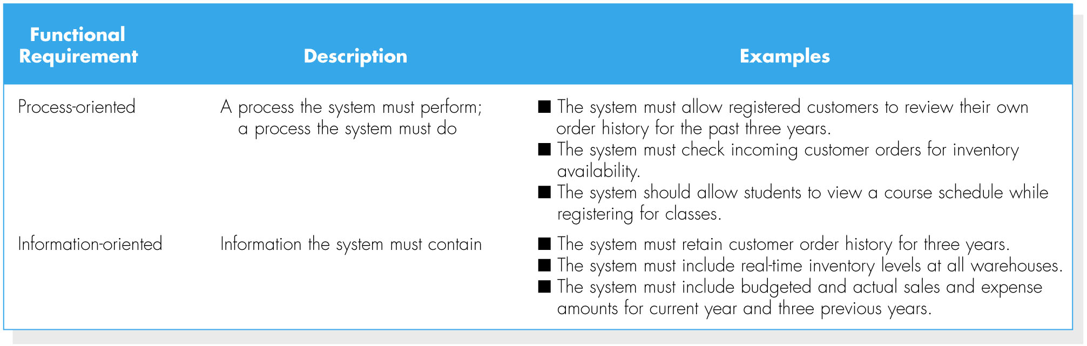
(cont’d)
Functional requirements
  what the software should do

Slide 10
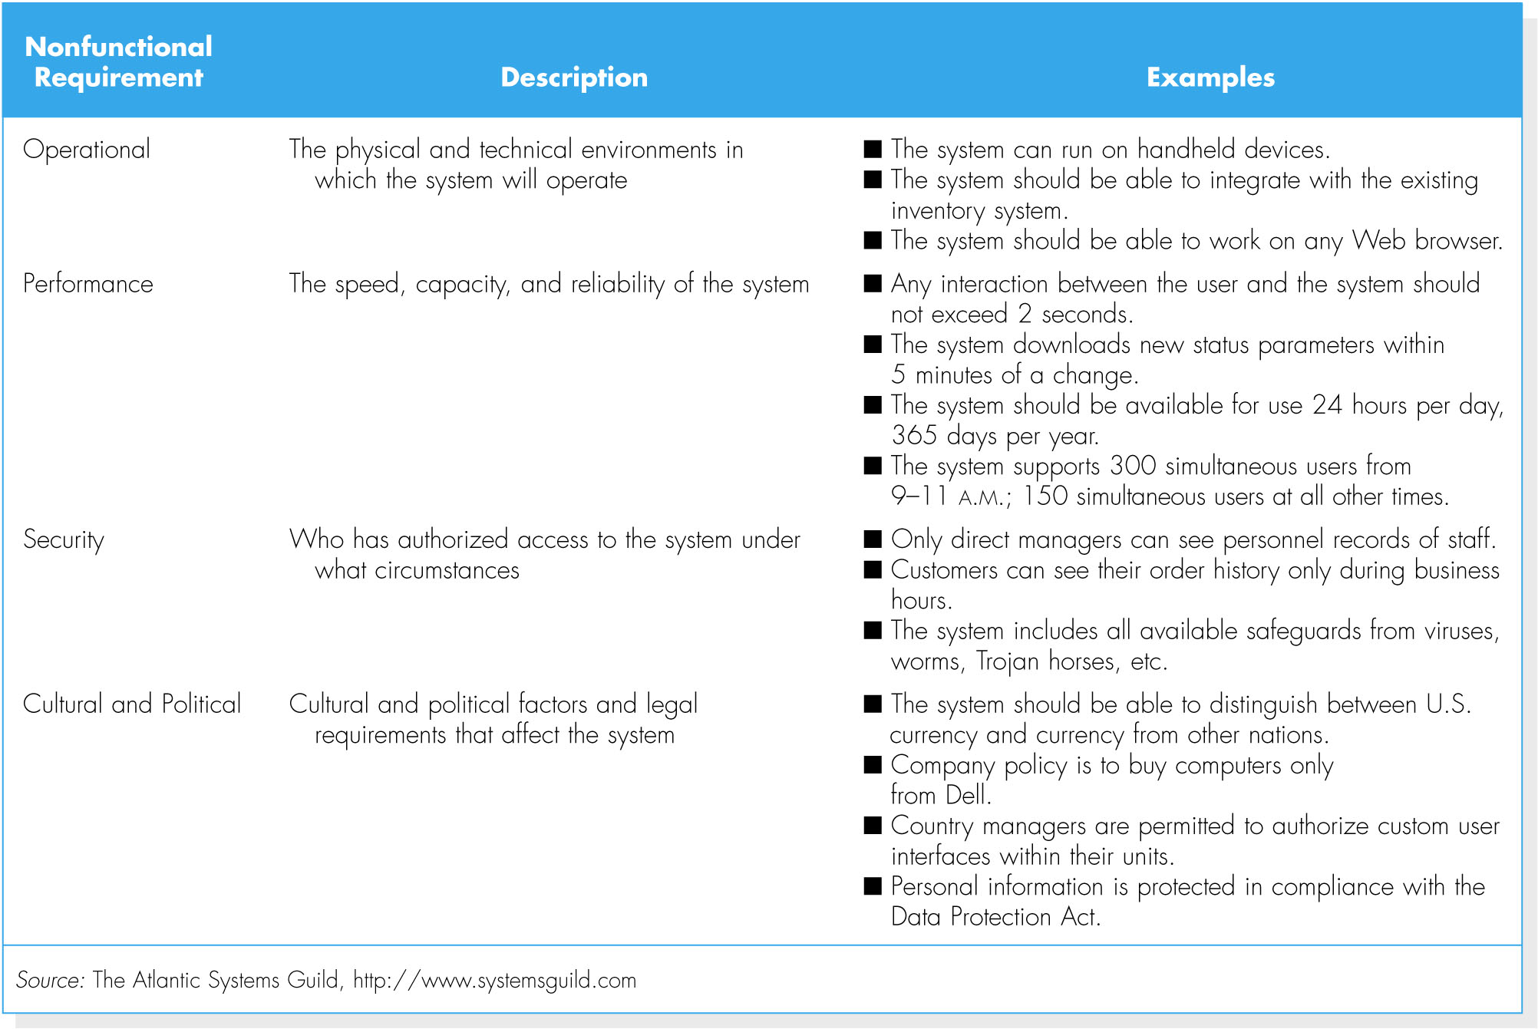
(cont’d)
Nonfunctional requirements
  characteristics the system should have

Slide 11
Requirement Engineering Processes
Feasibility studies
Requirements elicitation and analysis
Requirements Specification
Requirements validation
Notes:
-feasibility study) -assessing if the system is useful to the business
-Requirements elicitation and analysis -discovering requirements
-Requirements Specification-converting these requirements into some standard form
-Requirements validation - checking that the requirements actually define the system that the customer wants

Slide 12
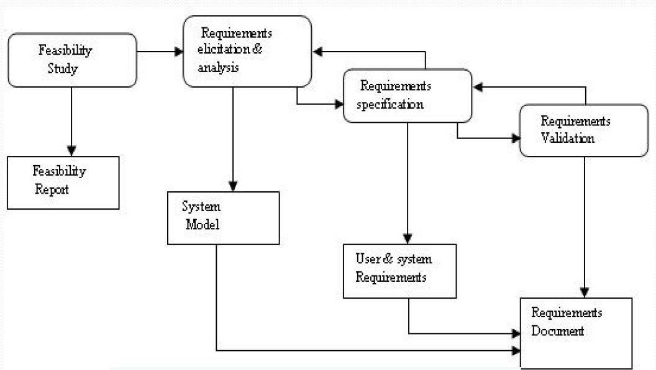

Slide 13
(cont’d)
Requirement | Example
Business requirement | Increase market share
User requirement | Schedule a client appointment
Functional requirement | Determine client availability Find available openings matching client availability Select desired appointment Record appointment Confirm appointment
Non-functional requirement | Operational – integrate with existing db Performance – availability of the system 24/7/365 Security – who can create the appointment Culture - meetings only from Monday – Thursday
System Requirement | All the requirements in the design phase

Slide 14
The Process of Determining Requirements
Both business and IT perspectives are needed to determine requirements during the analysis phase.
The most effective approach is to have both business people and analysts working together to determine requirements.
The analyst must also consider how best to elicit the requirements from the stakeholders.
The process of determining requirements continues throughout the analysis phase, and the requirements definition evolves over time.

Slide 15
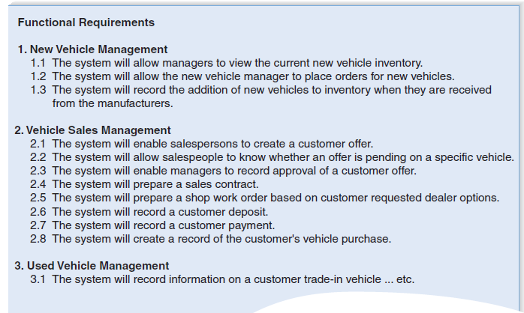
The Requirements Definition Statement

Slide 16
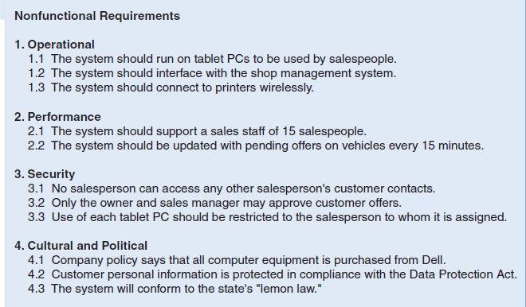

Slide 17
REQUIREMENTS ELICITATION AND ANALYSIS
The analyst should recognize that important side effects of the process of determining requirements include building political support for the project and establishing trust between the project team and the users.
The analyst should carefully determine who is included in the process of determining requirements.
Notes:
to get or produce something, especially information or a reaction:

Slide 18
Interviews
The most commonly used requirements elicitation technique
Basic steps:
  Selecting Interviewees
  Designing Interview Questions
  Preparing for the Interview
  Conducting the Interview
  Post-Interview Follow-up

Slide 19
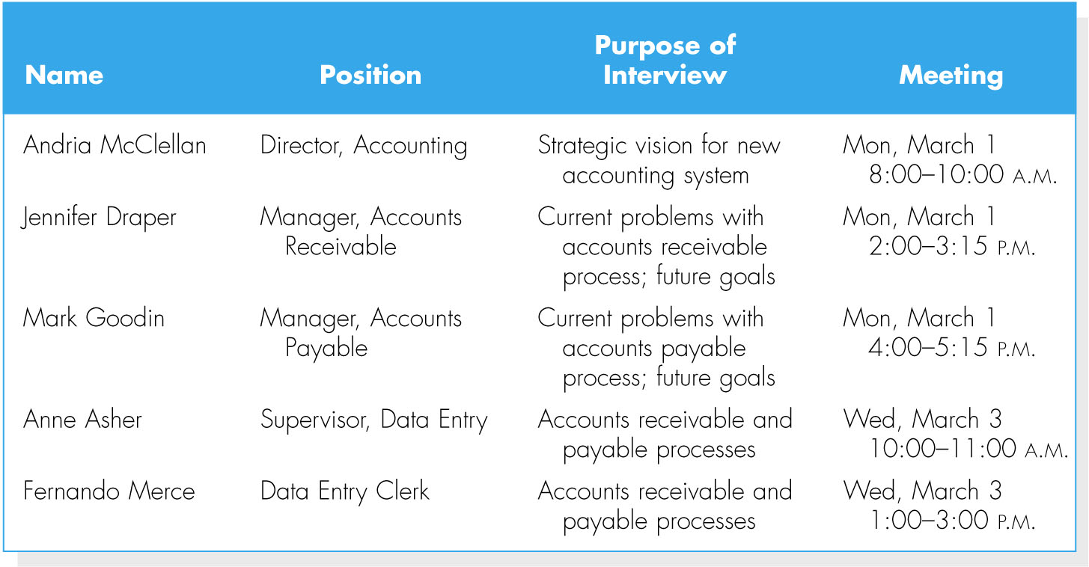
Selecting interviewees
Interview schedule
Including people at different levels of the organization
  Managers
  Users
  Other key stakeholders

Slide 20
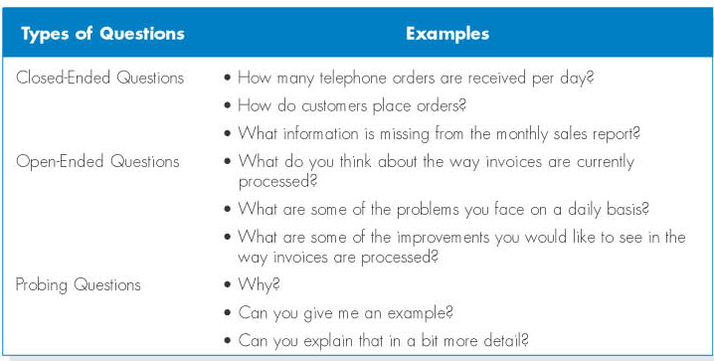
Designing interview questions

Slide 21
(cont’d)
Unstructured interview
  for a broad and roughly defined set of information
Structured interview
  for very specific information

Slide 22
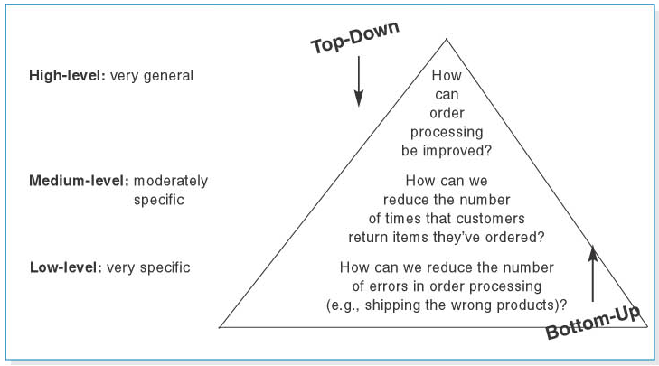
(cont’d)
Top-down vs. bottom-up interview

Slide 23
Preparing for the interview
Prepare a general interview plan
Confirm areas of knowledge
Set priorities in case of time shortage
Prepare the interviewee
  Schedule
  Inform of reason for interview
  Inform of areas of discussion

Slide 24
Conducting the interview
Appear to be professional and unbiased.
Record all information.
Be sure you understand the issues that are discussed.
Separate facts from opinions.
Give interviewee time to ask questions, and brief explain what will happen next.

Slide 25
Post-interview follow-up
After the interview, the analysts needs to prepare an interview report.
The report includes interview notes.
The report is sent to interviewee with a request to read it and inform the analyst of clarification and updates.

Slide 26
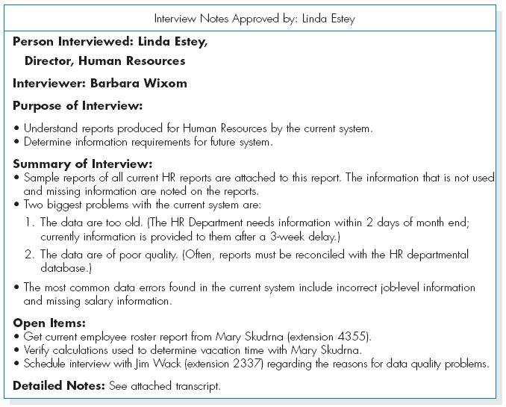
Post-interview follow-up…

Slide 27
Questionnaires
A questionnaire is a set of written questions for obtaining information from individuals.
Selecting participants - using a sample of people who are representative of the entire group.
Designing the questionnaire – following good practice guidelines.
Administering the questionnaire – improving the response rates.
Questionnaire follow-up – developing a report.

Slide 28
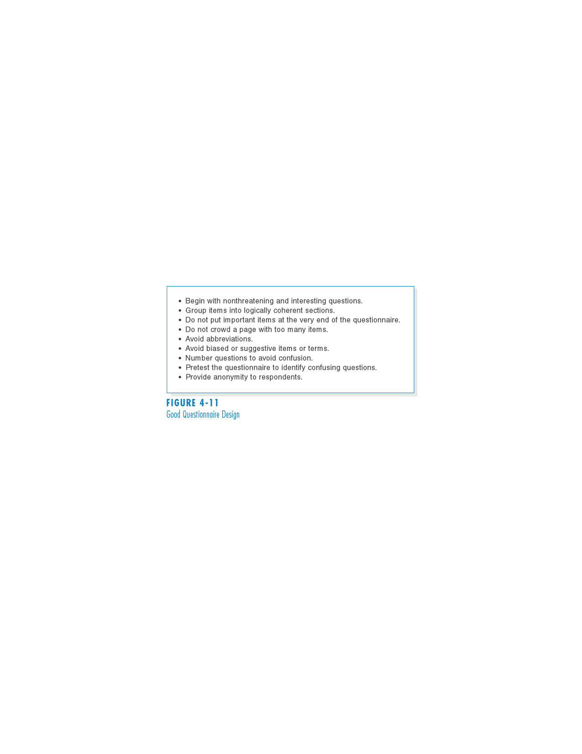
(cont’d)
Good questionnaire design

Slide 29
Document Analysis
Document analysis is used to understand the as-is system.
Forms, reports, policy manuals, organization charts describe the formal system that the organization uses.
The “real” or informal system differs from the formal one, and reveals what needs to be changed.
The indication that system needs to be changed is when users create new forms or make changes to the existing forms/reports.

Slide 30
Observation
Observation – the act of watching processes being performed.
It is a powerful tool to gain insight into the as-is system, and to check the validity of information gathered from other sources.
Nonetheless, people tend to be extremely careful in their behaviors when they are being watched.

Slide 31
Joint Application Development (JAD)
JAD is an information gathering technique that allows the project team, users, and management to work together to identify requirements for the system.
Developed by IBM in late 1970s
It can reduce scope creep by 50%,
JAD is a structure process in which 10 to 20 users meet under the direction of a facilitator skilled in JAD techniques.
Notes:
Give them to search about JAD.

Slide 32
Selecting the Appropriate Techniques
Type of information
  As-is system(mostly doc analysis/observation)
  new improvements
  to-be system
Depth of information
  How rich and detailed the info
Breadth of information
  Range of info
Integration of information
  Conflicting facts and opinions
User involvement
  They are cost
Cost
  Users time, consultancy wages
Combining techniques
Notes:
is that breadth is the extent or measure of how broad or wide something is while depth is the vertical distance below a surface; the degree to which something is deep.

Slide 33
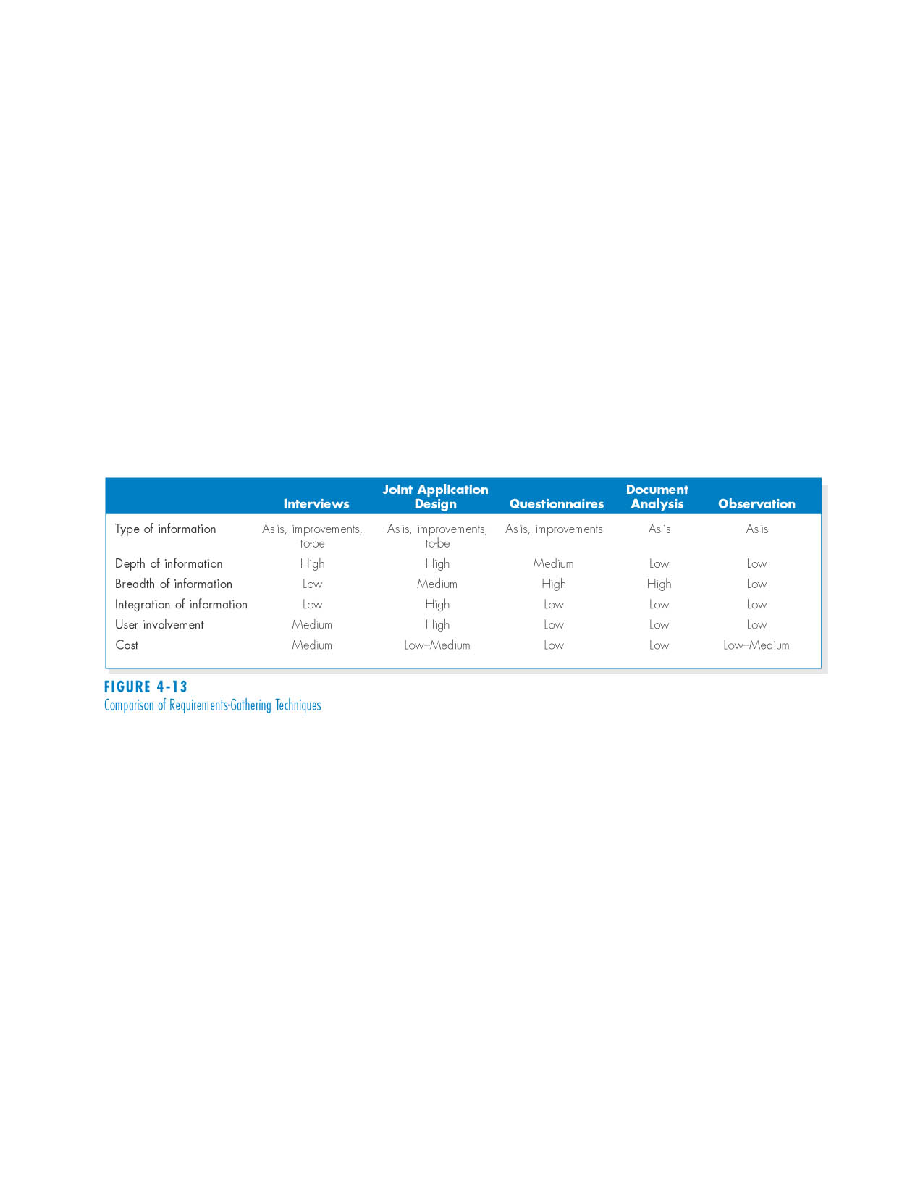
(cont’d)
Comparison of Requirements Elicitation Techniques

Slide 34
REQUIREMENTS ANALYSIS STRATEGIES
Problem Analysis
  Asking users to identify problems and solutions
  Improvements from problem analysis tend to be small and incremental
  This type of improvements often is very effective at improving a system’s efficiency or ease of use; however, it provides minor improvements in business value.

Slide 35
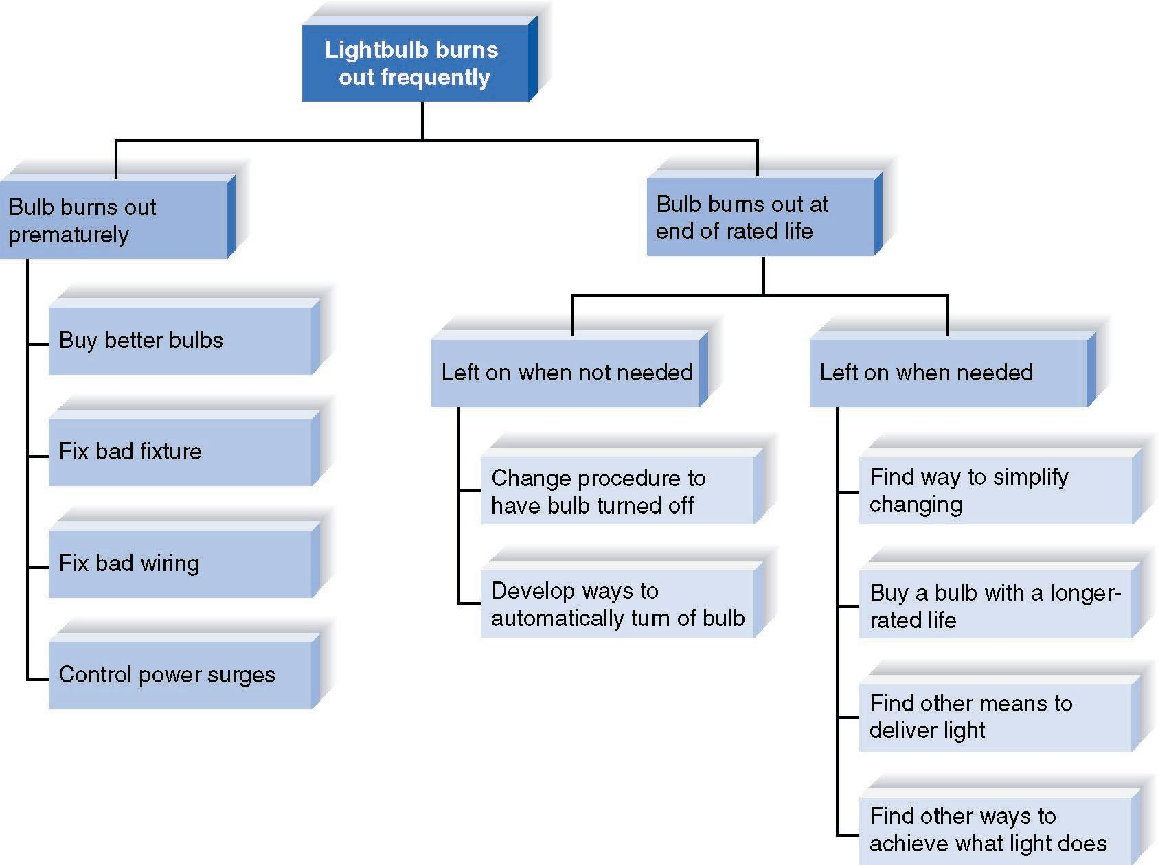
Root Cause Analysis
Root cause analysis focuses on problems first rather than solutions.

Slide 36
Duration Analysis
Duration analysis requires a detailed examination of amount of time it takes to perform each process in the as-is system.
Compare the total time to complete basic steps and the total time for the overall process – a significant difference indicates that the process is badly fragmented.
Potential solutions:
  Process integration
    Change fundamental process / use few people
  Parallelization
    Process simultaneously / check credit whilst title check in mortgage

Slide 37
Activity-Based Costing
Activity-based costing examines the cost of each major process or step in a business process.
Both direct and indirect costs are considered.
The analysts identify most costly steps and focus improvement efforts on them.

Slide 38
Informal Benchmarking
Benchmarking refers to studying how other organizations perform a business process.
Informal benchmarking is common for “customer-facing” processes*.
The analysts visit other organizations as customers to watch how the business process is performed.
* Processes that interact with the customer
Notes:
Benchmarking refers to studying how other organizations perform a business
process in order to learn how your organization can do something better. Benchmarking
helps the organization by introducing ideas that employees may never have
considered, but that have the potential to add value.
For example, suppose that the team is developing a Web site for a car dealer. The project sponsor, key managers, and key team members would likely visit the Web sites of competitors, those of others in the car industry (e.g., manufacturers,
accessories suppliers), and those of other industries that have won awards for their Web sites

Slide 39
Outcome Analysis
Outcome analysis focuses on understanding fundamental outcomes that provide value to customers.
Think what the organization could enable the customer to do
  In an insurance company, they pay for repair but provide body repair shop / a temporary vehicle to them

Slide 40
Technology Analysis
Technology analysis involves two steps:
1. The analysts and managers list important and interesting technologies.
2. Then, the group identifies how each and every technology might be applied to the business and how the business would benefit.

Slide 41
Comparing Analysis Strategies
Each of the requirement analysis strategies has its own purpose.
No one strategy is inherently better that the others.
The requirement analysis strategy should be chosen to fit the nature of the project.

Slide 42
SUMMARY
Analysis focuses on capturing the business requirements for the system
Requirement Determination is the part of analysis in which the project team turns the business requirements stated in the system request into a precise list of requirements.
Five Requirements Elicitation Techniques can be used to elicit business requirements.
Requirements Analysis Strategies are useful for analysts to help the business users think critically about the new system requirements.

